Slide 1
2017/18 Financial Aid High School Presentation
New Jersey Higher Education Student
Assistance Authority

Slide 2
Executive Director, Admissions and Financial Aid Rowan College at Gloucester County
Michael Chando

Slide 3
The Mission
The Higher Education Student Assistance Authority is the only State agency with the sole mission of providing students and families with the financial and informational resources to pursue their education beyond high school.
Notes:
HESAA Information Detailed:
Financial aid session
FAFSA Days
Booklets: State and Federal Aid, Financial Aid Dictionary, Student Loan Guide, and Reach Higher the College Planning Booklet.
Handouts: Eight Steps to Apply, Financial Planning Chart, and program brochures are available for free.
REAL $ 101 Financial Literacy on-site Sessions

Slide 4
Goals of Financial Aid Office
Primary goal is to assist students in paying for college and is achieved by:
Evaluating family’s ability to pay for educational costs
Distributing limited resources in an equitable manner
Providing a balance of gift aid and self-help aid
Implement federal and state regulations for their college/university
Notes:
Gatekeepers of the financial aid funds.

Slide 5
Help! Sources of Aid
Types of Financial Aid
Federal
State of New Jersey
The College/University
Outside Organizations
Civic organizations (ex.-local Rotary Club), parent’s employer, high school awards
Grants
Scholarships
Loans
Employment Opportunities

Slide 6
Net Price Calculator
All institutions must have a net price calculator posted on their websites.
Students will be able to estimate the individual net price per institution.
Based on full-time, first degree/certificate-seeking undergraduate students.
Notes:
HESAA also has on the website the NJEI calculator that calculates Federal PELL & TAG for estimate purposes only.

Slide 7
Types of Aid - Federal
Gift Aid - Grants
Federal Government 2016/17
Pell ($5,815 projected award)
SEOG ($4,000 max award)
TEACH ($3,728 max award)
Awards subject to change for 2017/18.
Notes:
Speaker Notes
PELL- SEOG
Named after senator Pell of Rhode Island, Pell is covered under the Higher Education Act of 1965
Pell is need based and all those with an EFC low enough are eligible so long as he or she has not received a first bachelor’s degree yet or are enrolled in a post baccalaureate program that leads to a teacher’s certification or licensure
Currently, the maximum amount is $5730 and for 2014 – 2015. The amount of the award will depend on financial need, cost of attendance, and full time or part time status
The limit on Pell is 12 semesters in duration.
SEOG can range from $100 to $4000 – funding is provided by the US Department of Education to institutions to manage. Goes to most needy first and are very limited.
The TEACH Grant As a condition for receiving a TEACH Grant, you must sign a TEACH Grant Agreement to Serve in which you agree to (among other requirements) teach
in a high-need field
at an elementary school, secondary school, or educational service agency that serves students from low-income families
for at least four complete academic years within eight years after completing (or ceasing enrollment in) the course of study for which you received the grant.
For any 2015–16 TEACH Grant first disbursed on or after Oct. 1, 2014, and before Oct. 1, 2015, the maximum award of $4,000 is reduced by 7.3 percent ($292), resulting in a maximum award of $3,708.
For any 2015–16 TEACH Grant first disbursed on or after Oct. 1, 2015, and before Oct. 1, 2016, the maximum award of $4,000 is reduced by 6.8 percent ($272), resulting in a maximum award of $3,728.
Iraq and Afghanistan Service Grants
The Iraq and Afghanistan Service Grant is provided to certain students whose parent or guardian was a member of the U.S. armed forces and died as a result of military service performed in Iraq or Afghanistan after the events of 9/11. May not be eligible for a federal PELL Grant but must meet remaining eligibility requirements. For any 2014–15 Iraq and Afghanistan Service Grant first disbursed on or after Oct. 1, 2013, and before Oct. 1, 2014, the maximum award of $5,730 is reduced by 7.2 percent ($412.56), resulting in a maximum award of $5,317.44. For any 2014–15 Iraq and Afghanistan Service Grant first disbursed on or after Oct. 1, 2014, and before Oct. 1, 2015, the maximum award amount of $5,730 is reduced by 7.3 percent ($418.29), resulting in a maximum award of $5,311.71.

Slide 8
Types of Aid – State
State of New Jersey
TAG (Tuition Aid Grant) 2016 - 2017
Demonstrate Financial Need
Be a U.S. citizen or eligible non-citizen
Must be New Jersey Resident & attend a New Jersey Institution
Must be full time at an approved degree program
Meet all state deadlines
Part-Time TAG for County Colleges 2016 -2017
Meet all TAG requirements
With the exception of being enrolled for 6-11 credits
Notes:
EOF (excellent program for financially and economically disadvantaged students)
EOF supports a wide array of campus-based outreach and support services to help program participants succeed and graduate
Benefits
Students enrolled in an EOF program receive financial assistance through annual grants ranging from $200 to $2,500. Family must have a documented history of financial and economic disadvantage - Some schools require that you are a first generation college student.
The amount of the grant varies depending upon financial need, cost of attendance and available funding. Awards are renewable annually based on continued eligibility.
GUS - $1,000 annual award – top 5% of HS graduating class
Asbury Park City
Camden City
East Orange City
Irvington Township
Jersey City
Lakewood Township
Millville City
Newark City
New Brunswick City
Paterson City
Plainfield City
Roselle Borough
Trenton City
Vineland City

Slide 9
Types of Aid – State (cont.)
State of New Jersey
EOF (Educational Opportunity Fund)
Award ranges from $200 - $2,500 annually depending on type of institution
Must demonstrate educational and economically disadvantaged background
File FAFSA
Governor’s Urban Scholarship
Rank within the top 5% of their class at the end of junior year
Attain a 3.0 GPA at the end of the junior year
Attend an approved New Jersey college or University and reside in a designated community
Have a New Jersey Eligibility Index below 10,500
Notes:
EOF (excellent program for financially and economically disadvantaged students)
EOF supports a wide array of campus-based outreach and support services to help program participants succeed and graduate
Benefits
Students enrolled in an EOF program receive financial assistance through annual grants ranging from $200 to $2,500. Family must have a documented history of financial and economic disadvantage - Some schools require that you are a first generation college student.
The amount of the grant varies depending upon financial need, cost of attendance and available funding. Awards are renewable annually based on continued eligibility.
GUS - $1,000 annual award – top 5% of HS graduating class
Asbury Park City
Camden City
East Orange City
Irvington Township
Jersey City
Lakewood Township
Millville City
Newark City
New Brunswick City
Paterson City
Plainfield City
Roselle Borough
Trenton City
Vineland City

Slide 10
Types of Aid – State (cont.)
State Scholarships
NJ STARS
NJ residents who rank in the top 15% of their class at either the end of junior or senior year
Achieve the required score on a college placement test to determine college readiness
Students must take at least 12 college credits
Students must attain a cumulative GPA of 3.0 or higher at the start of the third semester at the county college to remain an NJ STAR
Must file a Free Application for Federal Student Aid (FAFSA)
NJ STARS II
Received NJSTARS funding and have a family taxable income of less than $250,000
Must earn an associates degree and graduate with a 3.25 GPA or higher
May receive up to $2,500 annually for a public or private 4-year NJ college or university
Must enroll full time (12 credit hours)
Must file a Free Application for Federal Student Aid (FAFSA)
Notes:
Governor Christie signed Public Law 2012, Chapter 8 (PL 2012, c.8) into law on May 2, 2012 amending the NJ STARS and NJ STARS II Programs to make them more sustainable.
Limits the amount of the NJ STARS scholarship to tuition only. Budgetary footnote language has limited NJ STARS awards to tuition only since fall 2010 for new program participants.
Eligibility requirements are unchanged.
Must graduate in the top 15.0% of their high school graduating class.
NJ STARS-eligible students must file a FAFSA and complete the State grant record within established State deadlines.
Students may be eligible to receive NJ STARS awards for up to five semesters. Funds are not available to cover summer payments.
NJ STARS-eligible high school graduates may receive awards based on tuition only, after deducting any other federal and/or State grants and scholarships.
Students must attain a minimum cumulative grade point average (GPA) of 3.0 or higher at the start of the third semester of county college enrollment to remain eligible for NJ STARS. Summer courses are included in determining the cumulative GPA.
Students must maintain continuous full-time enrollment unless on a medical leave that is approved by the county college prior to the completion of the semester for which the leave is being granted.
NJSTARS II
Eligibility Requirements as follows:
Earn an associate degree from their home New Jersey county college as an NJ STARS recipient. Must graduate with a cumulative GPA of 3.25 or higher.
Family income (taxable and untaxed income) must be less than $250,000 as derived by the FAFSA
Meet all other program eligibility requirements, including admission into a baccalaureate program at a New Jersey four-year public or private college or university that participates in the TAG program
Complete a FAFSA and the State grant record within established State deadlines
NJ STARS II benefits for non-renewal students were changed by Bill PL 2012, c.8
Non-renewal NJ STARS II students may receive up to $1,250 per semester, paid completely by the State, after all other sources of federal and State grants and scholarships are applied to tuition charges.
Open to all four-year TAG-participating institutions-public or private

Slide 11
Types of Aid – State (cont.)
State Scholarships
Governor’s Industry Vocation Scholarship for Women & Minorities (NJ - GIVS)
Up to $2,000 per year for the cost of enrollment at one of New Jersey’s 19 County Colleges
Benefits women and minorities pursuing certificate or degree programs in construction – related fields
Must be NJ resident
Must file a FAFSA & complete separate application online at www.njgrants.org
Some of the programs eligible for the scholarship include
Construction Supervision
Solar Energy Technology
Architectural Engineering Technology
Notes:
For use in the 19 county colleges – $2,000 annually less any other grants or scholarships
Must file a FAFSA within deadlines
Enroll at a NJ County College
Demonstrate financial aid need with an NJEI below 10,500
Maintain SAP requirements

Slide 12
Self Help Loans & Gap Shortfall Solutions
Monthly Payment Plans – offered by the college
Federal Perkins Loan up to $5,500 (5% interest rate)
Federal Direct Loan Program (1st year dependent student)
Subsidized Stafford Loan $3,500 need based
Unsubsidized Stafford Loan $2,000 additional
2016 - 2017 - Federal Direct Undergraduate Direct Loans are 3.76% plus a 1% origination fee
2017 – 2018 Rates and fees are subject to change
Notes:
Origination fees further increase from 1.072% to 1.073% for all new loans disbursed after December 1, 2014
Federal student loans are now Variable – Fixed
Rates are determined each year in May and will be fixed for the life of the loan – the federal government will publish new 2015/16 interest rates next May 2015.

Slide 13
Self Help Loans to Cover the Gap borrow up to cost of attendance
2016 -2017 - NJCLASS Supplemental Loan Program
10 Year Fixed Rate NJCLASS LOAN, starting at 4.48% / 5.52% APR
This option has 3% origination fee
15 Year Fixed Rate NJCLASS LOAN is 5.19% / 6.10% APR
This option is also a 3% origination fee and students / families can borrow up to the cost of attendance. Interest only payments while in school available for this repayment plan
20 Year Fixed Rate NJCLASS LOAN is 7.15% / 8.23% APR
This option has 3% origination fee
Federal PLUS Program (6.31% & 4.262% Origination fee)
Parent is the borrower
2017 – 2018 Rates and fees are subject to change
Notes:
Private Loans
Refer to FA Dictionary
Adjustable Rate, Libor
Talking Points..
Difference between a fixed rate loan and an adjustable rate loan.
Student can be the borrower
Can borrower for a previously completed term
Repayment term up to 20 years
Three different repayment options
Borrower up to the Cost of Attendance less the federal subsidized Stafford loan
The NJCLASS 10 year repayment option offer s a substantial interest savings over the Federal PLUS loan
NJCLASS is first come first served
Sequestration year #1
Origination fees increased from 4% to 4.204% deducted from each disbursement
Sequestration year #2
Origination fees further increase from 4.204% to 4.288% for all new loans disbursed after December 1, 2013
Federal parent loans are now Variable – Fixed
Rates are determined each year in May and will be fixed for the life of the loan – the federal government will publish 2014/15 interest rates next May 2014.

Slide 14
Institutional & Private Scholarships
Factors that may influence eligibility:
Academics | Athletic Ability*
SAT’s | Geographic Diversity
AP Courses | Legacy (child of alumni)
Activities | Talent
Academic Track | Gender/Ethnicity
H.S. Attended | Class Rank
* Athletic awards offered by NCAA Division I and Division II schools only.

Slide 15
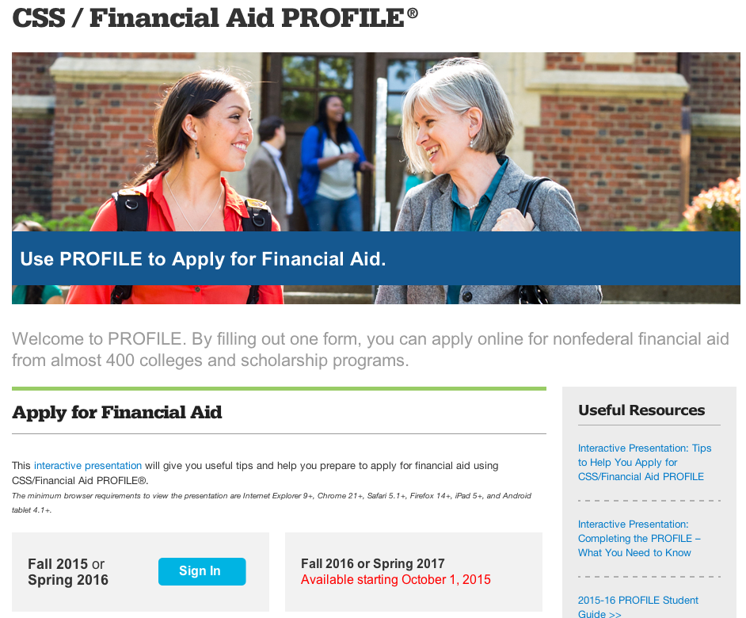
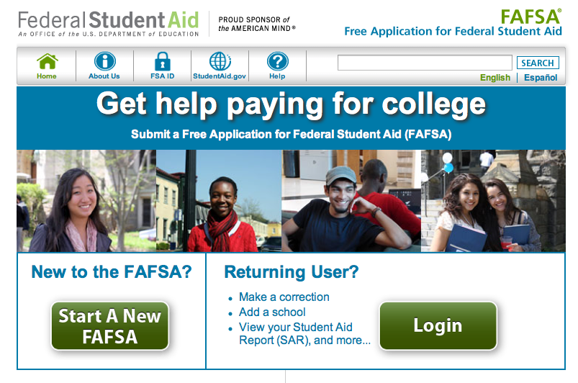
Applications to Access Aid
student.collegeboard.org/profile
fafsa.ed.gov

Slide 16
Application: CSS Profile
Nearly 400 Colleges and Organizations use the CSS profile to determine how they will award institutional funds
Available 10/1 each year and collects more comprehensive income, asset and household information than the FAFSA (i.e. assets for business owners regardless of number of employees
Aligns with the FAFSA’s use of prior prior year income (currently 2015)
Register - Complete Application – Make payment - Submit
Notes:
Check out http://student.collegeboard.org/profile for a list of institutions that require CSS profile
CSS profile uses institutional methodology formula whereas FAFSA uses federal methodology
The CSS profile is a fee based application. The cost for filing the CSS PROFILE is $25 for the first college, and there is an $16 processing fee for each additional college. This is not the FAFSA. The FAFSA is free.
Can take 45 minutes to 2 hours to complete
Can leave some answers blank but an error will prompt if answer is required but most numeric questions at least require a zero

Slide 17
CSS Profile
Website to apply for profile
www.student.collegeboard.org/profile
Website to apply for Noncustodial Profile:
www.ncprofile.collegeboard.org
Customer Service
305-829-9793
help@cssprofile.org
17
Notes:
Hours are Monday through Friday 9 – 6 but extended hours are 8 – 10 from January through April

Slide 18
Application: FAFSA
2017-2018 FAFSA available October 1, 2016
FAFSA will use prior prior year income information (20l5)
IRS Data Retrieval Tool can be used immediately
All prior prior year tax information (2015) is already filed, allowing immediate retrieval.
Notes:
Some college especially for early decision… need the CSS profile to be completed…it is a fee based application. The cost for filing the CSS PROFILE is $25 for the first college, and there is an $16 processing fee for each additional college. This is not the FAFSA. The FAFSA is free.
Many schools also use the CSS PROFILE Financial Aid Form, a financial aid profile produced by the College Board. The acronym "CSS" stands for College Scholarship Service.
The CSS PROFILE form is used primarily by colleges for determining non-federal financial aid, such as institutional scholarships, grants, and loans. The CSS PROFILE is also a more detailed questionnaire than the FAFSA, focusing on information about the specific programs at schools you will be applying to.

Slide 19
Application: FAFSA
Submit the Free Application for Federal Student Aid (FAFSA) prior to the earliest school’s deadline & complete the NJ State Specific Questions
To ensure maximum consideration for federal, state, and institutional aid, check information from each school to determine:
Required application materials
Application deadlines
Notes:
Some college especially for early decision… need the CSS profile to be completed…it is a fee based application. The cost for filing the CSS PROFILE is $25 for the first college, and there is an $16 processing fee for each additional college. This is not the FAFSA. The FAFSA is free.
Many schools also use the CSS PROFILE Financial Aid Form, a financial aid profile produced by the College Board. The acronym "CSS" stands for College Scholarship Service.
The CSS PROFILE form is used primarily by colleges for determining non-federal financial aid, such as institutional scholarships, grants, and loans. The CSS PROFILE is also a more detailed questionnaire than the FAFSA, focusing on information about the specific programs at schools you will be applying to.

Slide 20
CAUTION!
Please, avoid being charged a fee to file the FAFSA
Completing and processing the FAFSA is FREE
If filing FAFSA on the Web, make sure you go directly to: www.fafsa.gov
Contact the financial aid office or HESAA at 609-584-4480 if you need help in completing the FAFSA

Slide 21
Free Application for Federal Student Aid (FAFSA)
Collects family’s personal and financial information used to calculate the student’s Expected Family Contribution
File the FAFSA electronically
FAFSA on the Web at www.fafsa.ed.gov
Student & Parent must create a Federal Student Aid ID (FSA ID) at fsaid.ed.gov
Use the IRS Data Retrieval Tool to populate income & tax information with actual prior prior year tax information (currently 2015)
Notes:
8
You should use the IRS DRT at the time of filing the initial FAFSA. Using this tool will automatically verify your information for feder

Slide 22
What is a Federal Student Aid
(FSA) ID?
In order to enhance security, FAFSA has created a user name and password login
If you already have a PIN, you can link your information to your new FSA ID by entering your PIN while registering for your FSA ID
PIN number is not necessary to create a FSA ID
If you are a parent of a dependent student, you will need your own FSA ID
Notes:
The FSA id is a higher security login which will connect the student and parent to the FAFSA. The FSA id will also connect the student to the federal student aid website, and the National student loan data base.

Slide 23
General Highlighted Eligibility Requirements
Must have a valid Social Security Number
Must be enrolled or accepted for enrollment in an eligible program of study
Must be pursuing a degree, certificate, or other recognized credential
Must be a U.S. citizen or eligible noncitizen
Must be registered with Selective Service (males are required)
Notes:
If you are an eligible noncitizen, write in your eight- or nine-digit Alien Registration Number. Generally, you are an eligible noncitizen if you are (1) a permanent U.S. resident with a Permanent Resident Card (I-551); (2) a conditional permanent resident with a Conditional Green Card (I-551C); (3) the holder of an Arrival-Departure Record (I-94) from the Department of Homeland Security showing any one of the following designations: “Refugee,” “Asylum Granted,” “Parolee” (I-94 confirms that you were paroled for a minimum of one year and status has not expired), T-Visa holder (T-1, T-2, T-3, etc.) or “Cuban-Haitian Entrant;” or (4) the holder of a valid certification or eligibility letter from the Department of Health and Human Services showing a designation of “Victim of human trafficking.”
If you are in the U.S. on an F1 or F2 student visa, a J1 or J2 exchange visitor visa, or a G series visa (pertaining to international organizations), select “No, I am not a citizen or eligible noncitizen.” You will not be eligible for federal student aid. If you have a Social Security Number but are not a citizen or an eligible noncitizen, you should still complete the FAFSA because you may be eligible for state or college aid.
The Selective Service System and the registration requirement for your men, preserves America’s ability to provide manpower in an emergency to the US armed forces Almost all men ages 18 to 25 must register. For more information please visit 222.sss.gov

Slide 24
Key Components of the FAFSA
Student Demographics
Last Name
Social Security Number
Date of Birth
NJ applicants must provide an answer to the driver’s license questions.
ALL applicants must indicate their gender.
Student Income and Assets
IRS Data Retrieval
Income earned from work
Student Status: Dependent/Independent
Parent Demographics-Who is a Parent?
Social Security Number
Last Name
Date of Birth
Notes:
6
WHO IS THE PARENT
If your parent was never married and does not live with your other legal parent, or if your parent is widowed or not remarried, answer the questions about that parent.
• If your legal parents (biological and/or adoptive) are not married to each other and live together, select “Unmarried and both parents living together” and provide information about both of them regardless of their gender. Do not include any person who is not married to your parent and who is not a legal or biological parent. Contact 1-800-433-3243 for assistance in completing questions 80-94.
• If your parents are married, select “Married or remarried.” Consistent with the Supreme Court decision holding Section 3 of the Defense of Marriage Act (DOMA) unconstitutional, same-sex couples must report their marital status as married if they were legally married in a state or other jurisdiction (foreign country) that permits same-sex marriage, without regard to where the couple resides. If your legal parents are divorced but living together, select “Unmarried and both parents living together.” If your legal parents are separated but living together, select “Married or remarried,” not “Divorced or separated.”
• If your parents are divorced or separated, answer the questions about the parent you lived with more during the past 12 months. (If you did not live with one parent more than the other, give answers about the parent who provided more financial support during the past 12 months or during the most recent year that you actually received support from a parent.) If this parent is remarried as of today, answer the questions about that parent and your stepparent.
• If your widowed parent is remarried as of today, answer the questions about that parent and your stepparent.

Slide 25
Key Components of the FAFSA (cont.)
Household Size
Number in college
Parent(s) Income and Assets
IRS Data Retrieval
Income earned from work
Dislocated Worker
Federal Means Tested Benefits
Medicaid, SSI, SNAP, Free or Reduced Price School Lunch, TANF, WIC
College Choice
List all colleges of interest (up to 10)
Once submitted, use the link from the FAFSA confirmation page to HESAA’s portal to complete the additional data elements for Tuition Aid Grant (TAG) and NJ STARS (II) eligibility.
Applicants who bypass answering the State questions, should log into www.njgrants.org
Students must create a user ID and password to answer the State specific questions
Notes:
6
# in College
Always count yourself as a college student. DO NOT Include your Parents. Include others only if they will attend, at least half-time in 2015-2016, a program that leads to a college degree or certificate.
ASSETS
Net worth means current value minus debt. If net worth is negative, enter 0.
Investments include real estate (do not include the home in which you live), rental property (includes a unit within a family home that has its own entrance, kitchen, and bath rented to someone other than a family member), trust funds, UGMA and UTMA accounts, money market funds, mutual funds, certificates of deposit, stocks, stock options, bonds, other securities, installment and land sale contracts (including mortgages held), commodities, etc.
Investments also include qualified educational benefits or education savings accounts (e.g., Coverdell savings accounts, 529 college savings plans and the refund value of 529 prepaid tuition plans). For a student who does not report parental information, the accounts owned by the student (and/or the student’s spouse) are reported as student investments in question 42. For a student who must report parental information, the accounts are reported as parental investments in question 91, including all accounts owned by the student and all accounts owned by the parents for any member of the household.
Money received, or paid on your behalf, also includes distributions to you (the student beneficiary) from a 529 plan that is owned by someone other than you or your parents (such as your grandparents, aunts, and uncles). You must include these distribution amounts in question 45j.
Investments do not include the home you live in, the value of life insurance, retirement plans (401[k] plans, pension funds, annuities, non-education IRAs, Keogh plans, etc.) or cash, savings and checking accounts already reported in questions 41 and 90.
Investments also do not include UGMA and UTMA accounts for which you are the custodian, but not the owner.
Investment value means the current balance or market value of these investments as of today. Investment debt means only those debts that are related to the investments.
Business and/or investment farm value includes the market value of land, buildings, machinery, equipment, inventory, etc. Business and/or investment farm debt means only those debts for which the business or investment farm was used as collateral.
Business value does not include the value of a small business if your family owns and controls more than 50 percent of the business and the business has 100 or fewer full-time or full-time equivalent employees. For small business value, your family includes (1) persons directly related to you, such as a parent, sister or cousin, or (2) persons who are or were related to you by marriage, such as a spouse, stepparent or sister-in-law.
Investment farm value does not include the value of a family farm that you (your spouse and/or your parents) live on and operate.

Slide 26
Common Mistakes Made on the FAFSA
Student’s name as it appears on the social security card, social security number, and date of birth.
Parent section vs. Student section
Number of people in the household
Divorced/remarried households
Taxes paid vs. taxes withheld
Parental and student assets
“Zero” is a number
College grade level
Skipping the gender question
Notes:
6

Slide 27
How To Be Considered for State Aid
Complete the FAFSA by established State deadlines
Once you submit the FAFSA, NJ residents will be given the option to link to the Higher Education Student Assistance Authority’s portal to respond to additional questions to be considered for TAG, NJ STARS, NJ STARS II and other state programs.
Click the link and complete the additional New Jersey State questions. If questions not answered, student may log into “njgrants.org” to complete the additional questions for state aid.
HESAA will notify you via email of the status of your State grant application.
It is highly recommended to use a personal email address: all correspondence will go to the email address listed on the FAFSA
Notes:
Deadlines, Septemter 15 for prior year non TAG recipients
April 15 for prior year TAG recipients.

Slide 28
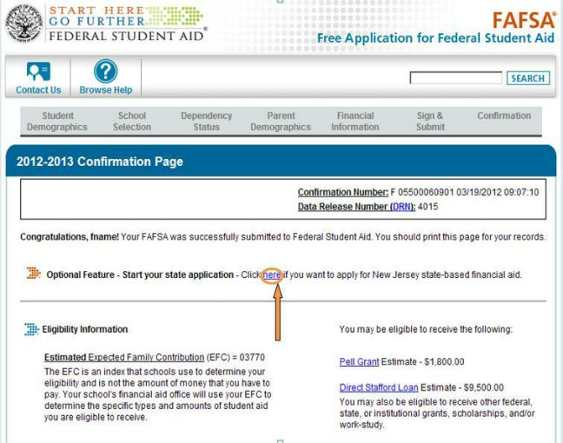
Click to Apply for State Aid
2017-2018

Slide 29
Cost of Attendance
Tuition and fees
Room and board
Books and supplies, equipment, transportation, and miscellaneous personal expenses
Loan fees
Study abroad costs
Dependent care expenses
Expenses related to a disability
Expenses for cooperative education program
Notes:
6

Slide 30
Unexpected Costs
Remediation Classes: extra 1 – 2 semesters
Change in major: 1 – 2 years in addition
Transferring: possible extra semester
Unpaid internships: loss of Summer wages
Study Abroad, Spring break, trips home and pledging costs
Moving expenses and Summer storage
30

Slide 31
What Is The Expected Family Contribution (EFC)?
Basis of financial aid package
EFC is determined by a federal formula that calculates need using the information you supplied on the FAFSA
EFC & Financial Need are guidelines used by schools to determine an aid package
EFC is not necessarily equal to a family’s out-of-pocket costs

Slide 32
Sample EFC for Smith Family
Family lives in New Jersey
Married parents, both age 52
Household size of 4 with 1 child going to college
2015 adjusted gross income = $120,000
Assets = $20,000
Student income / assets = 0
EFC = $20,830
32

Slide 33
Basic Calculation
COA-EFC=Need

Slide 34
Financial Need for Smith Family
College | Community College | State College or University | Private College or University
COA | $5,860 | $25,561 | $45,676
EFC | $20,830 | $20,830 | $20,830
Financial Need | 0 | $4,731 | $24,846
34
Notes:
All examples include approximate tuition, fees (left out new student fee), room and board for academic year.

Slide 35
Shopping Sheet
You may see the Shopping Sheet
The Shopping Sheet standardizes award letters, making it easier to comparison shop and provide students with key information including:
How much one year of school will cost.
Financial aid options to pay this cost, with a clear differentiation between grants and scholarships, which do not have to be repaid, and loans, which do.
The net costs after grants and scholarships are taken into account.
Fundamental information about student results, including information comparing default rates, graduation rates, and median debt levels for the school.
Potential monthly payments for the federal student loans the typical student would owe after graduation.
35
Notes:
Not all schools have implemented yet!
Many students when applying for college financial aid don't understand what they're signing up for. They often receive confusing financial aid letters -- loaded with inconsistencies -- from schools that make it difficult to accurately compare the costs of different colleges. The lines between grants, loans, work-study, need-based and non-need-based aid vary from school to school, making it difficult to compare packages.
Enter the Shopping Sheet-- an individualized standard financial aid letter designed to help students understand their costs before making the final decision on where to enroll. The Shopping Sheet will allow students to easily compare aid packages offered by different institutions. To create the Shopping Sheet, the U.S. Department of Education partnered with a new independent agency known as the Consumer Financial Protection Bureau (CFPB).
The Shopping Sheet reveals the costs and responsibilities of student loans upfront -- before students have enrolled -- outlining their total estimated annual costs, institutional rates of completion and default. Also included is an estimate of the monthly payments that will be expected upon graduation. The sheet also makes clear the difference between grants and scholarships, which students don't have to pay back, and loans, which they do.
The Shopping Sheet will standardize award letters, making it easier to comparison shop and provide students with key information including:
• How much one year of school will cost.
• Financial aid options to pay this cost, with a clear differentiation between grants and scholarships, which do not have to be repaid, and loans, that do.
• The net costs after grants and scholarships are taken into account.
• Fundamental information about student results, including information comparing default rates, graduation rates, and median debt levels for the school.
• Potential monthly payments for the federal student loans the typical student would owe after graduation.

Slide 36
The Cycle of Financial Aid
Oct - March - Complete FAFSA application, college search, college application process, and CSS Profile
February - May - Schools send award letters
June -July - School sends Fall Semester bill
Notes:
CSS Profile is essential for some colleges institutional aid.

Slide 37
Where Do I Go From Here?
Obtain and review admission, financial aid materials and deadlines from each school to which you are applying
Meet all application deadlines
CSS Profile if applicable
Complete the FAFSA and any other application materials required by the school or your state agency - NJ State deadlines are:
TAG Renewal Students – April 15, preceding the academic year for which aid is requested
All Other Applicants – September 15 for Fall and Spring term awards; February 15– Spring awards only

Slide 38
Other Resources
Outside Scholarships
Campus Administered Payment Plans
Campus Employment
Specialized Campus Opportunities
Residential Advisors
Student Ambassadors
Student Tour Guides
Internships/CO-OP’S

Slide 39
Private Scholarship Search
Institution/college web sites
Local library resources
Local businesses, civic organizations and churches
Parent’s employer(s)
www.hesaa.org
www.fastweb.com
www.collegeboard.org
www.mappingyourfuture.org

Slide 40
NJBEST College Savings Plan
NJBEST is the only 529 Savings Plan to award a scholarship ranging from $500-$1,500
Funding for NJBEST scholarships comes from HESAA
Earnings on the NJBEST Plan are tax free when used to pay for the qualified higher education expenses of an NJBEST beneficiary
Limit how much can be contributed annually
Notes:
Resource
www.njbest.com
Speaker Notes
A 529 is a tax advantaged investment plan created for American families to encourage saving for the future higher education expenses of a designated beneficiary
Scholarship is awarded within the first year
Investments grow federal income tax free and withdrawals for qualified higher education expenses are free from federal income taxes
Qualified withdrawals made by New Jersey residents are not subject to New Jersey State Income tax
A 529 can affect the student’s federal financial aid award, however, a maximum of 5.64% of parental assets can have an impact on determining financial aid eligibility where as it is 20% (up to) for students
If a dependent student is the account owner (after July 1, 2009), the available balance is treated as a parental asset
Anything above $25,000 is considered in determining eligibility for State scholarship or grant

Slide 41
HESAA Services
Web Sites
www.hesaa.org
www.njgrants.org
www.njclass.org
Customer Care Line
609-584-4480
NJBEST
MappingYourFuture.org

Slide 42
Questions?

Slide 43
RCGC OPEN HOUSE
Thursday, October 13th
5:30 pm to 8 pm
120 colleges and universities

Slide 44
Thank you

